Slide 1

Mini Project-I (K24MCA18P) Even Semester Session 2024-25
Sairam PaperFoil Website
Arun Kumar 202410116100040
Anurag Singh Kushwaha 202410116100039
Anshu Patel 202410116100034
Project Supervisor:
Dr. Vipin Kumar
Asso. Professor

Slide 2
Content
Introduction
Literature Review
Objective of the Project
Technology: Software Requirements
Modules
Workflow
Notes:
Font Styles: Times New Roman + Font Size: 25

Slide 3
Introduction
Sairam Paper Foils enable customers to place inquiries and purchase foil products online.
The website streamlines the ordering process and enhances business operations.
Aims to provide a user-friendly platform for exploring various foil products.
Notes:
Font Styles: Times New Roman + Font Size: 25

Slide 4
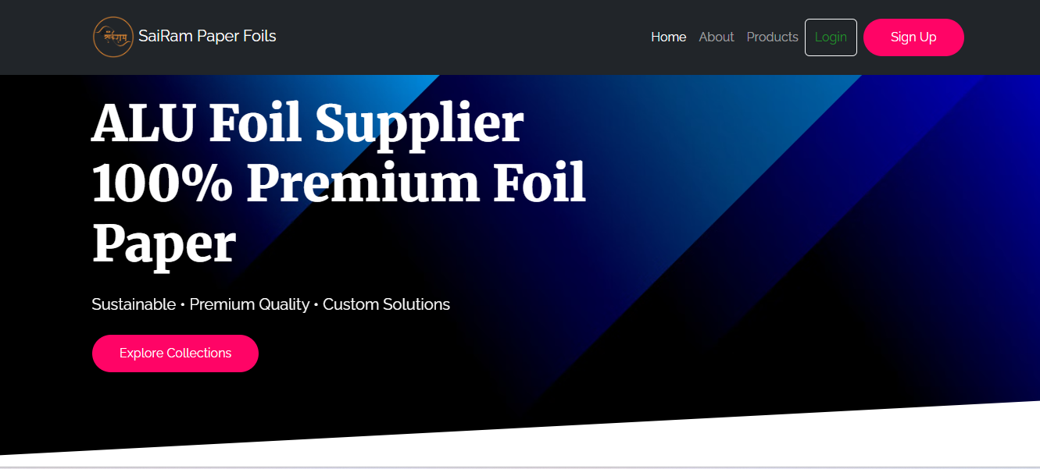
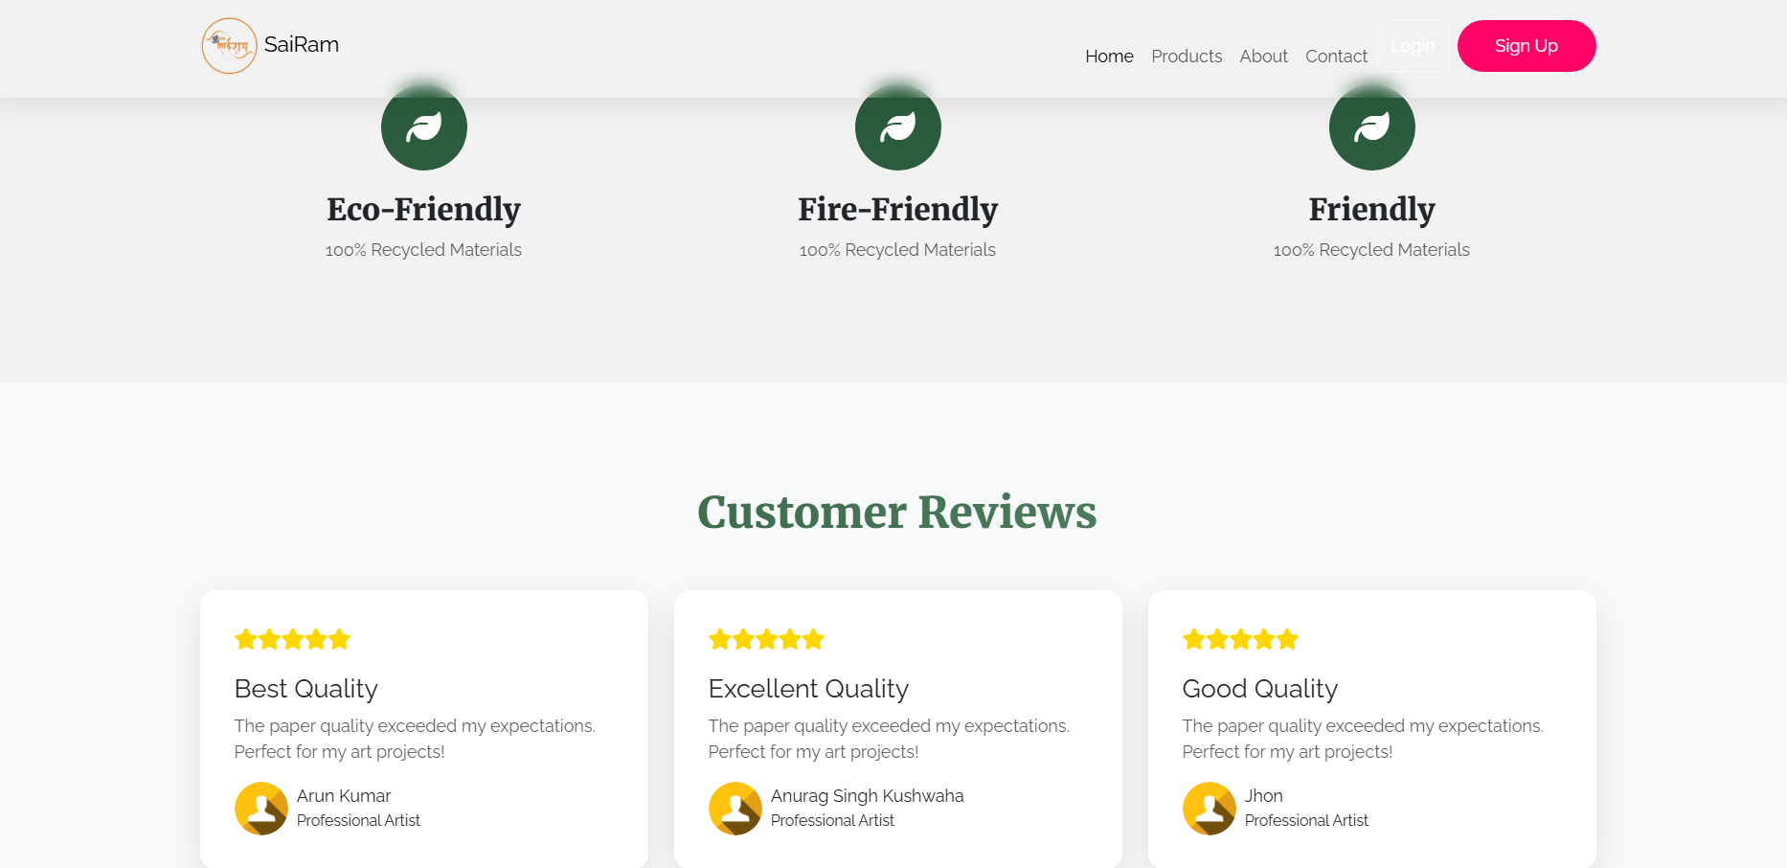
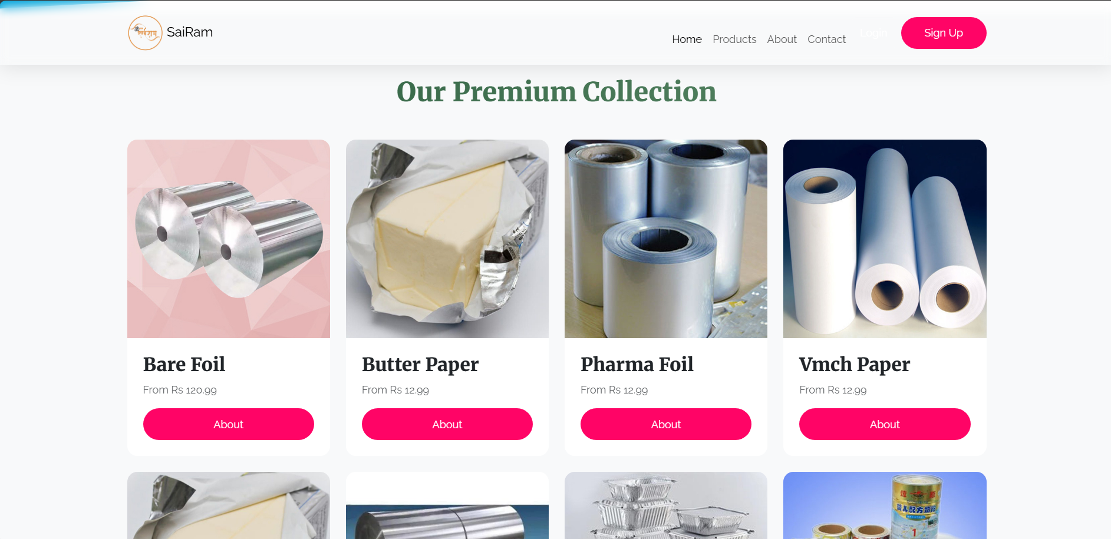
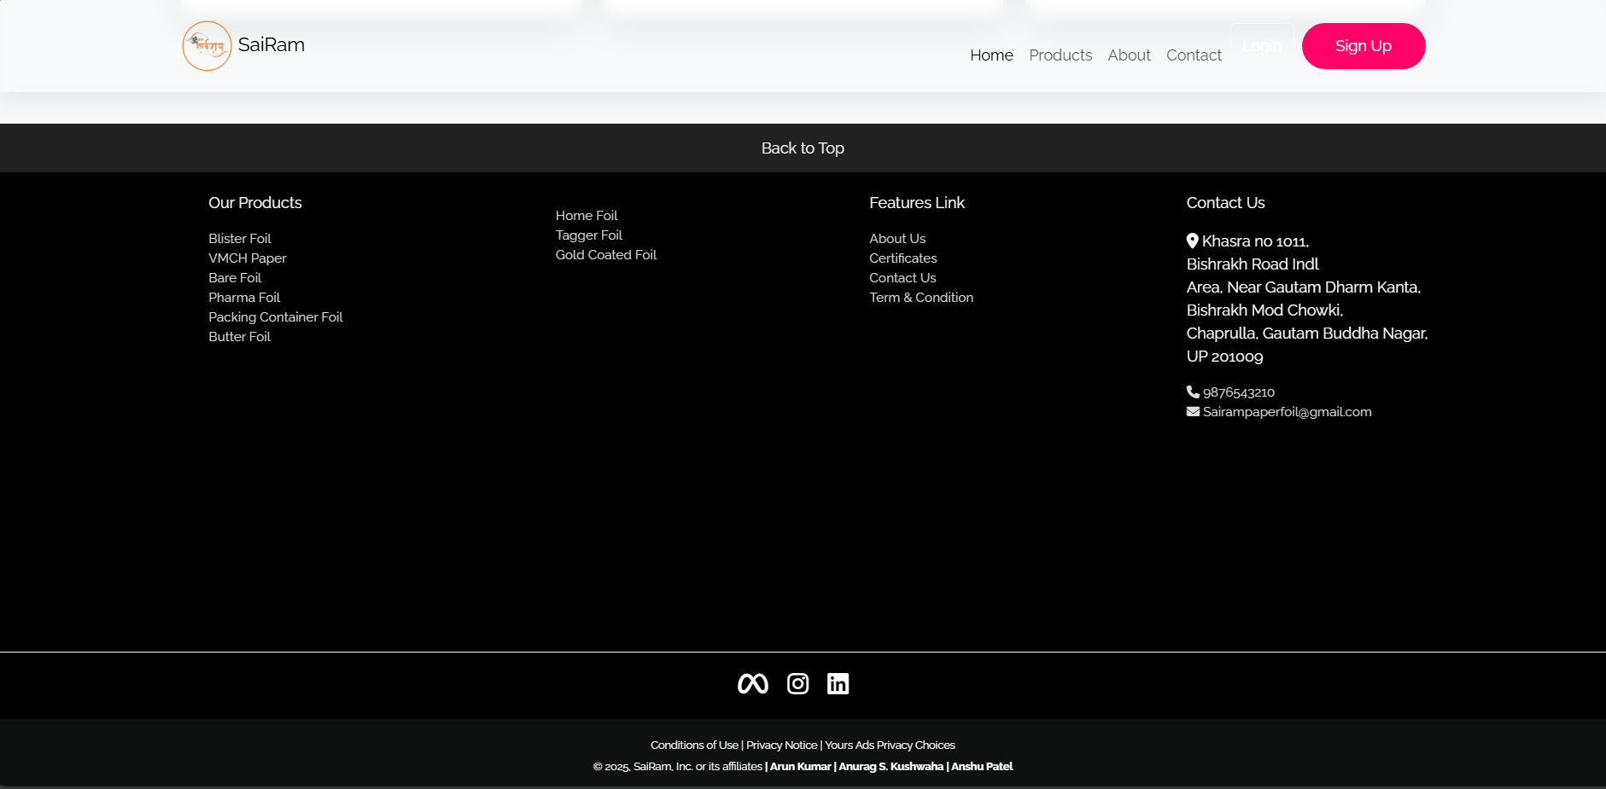
Notes:
Font Styles: Times New Roman + Font Size: 25

Slide 5
Literature Review
Industry Overview: Growing demand for foil products in packaging and industrial applications.
Challenges in Traditional Systems: Difficulty in manual order processing, lack of online presence, and limited customer reach.
Existing Market Solutions: Analysis of competitor platforms for foil product sales.
Their aluminium foil is a multilayer laminate comprising high-strength polyester film, aluminium foil, and co-extruded polymer.
Notes:
Font Styles: Times New Roman + Font Size: 25

Slide 6
Objective of the Project
To create an efficient and accessible platform for customers.
To simplify the process of placing product inquiries and orders.
To enhance business growth by leveraging digital tools.
To integrate a seamless communication channel between customers and the company.
Notes:
Font Styles: Times New Roman + Font Size: 25

Slide 7
Technology Used
FRONTED
1.HTML
2. CSS
3. JS
4.BOOTSTRAP
BACKEND
FIREBASE
JS
Notes:
Font Styles: Times New Roman + Font Size: 25

Slide 8
Modules
User Module: Customer registration, login, and profile management.
Product Module: Displaying various foil products with details.
Inquiry Module: Customers can send inquiries about products.
User Registration & Login Module
Order Management Module (For E-Commerce Functionality)
About Us Module
Notes:
Font Styles: Times New Roman + Font Size: 25

Slide 9
Workflow/Gantt Chart
User Journey
Visiting the Website: Users land on the homepage where they can explore various foil products.
Browsing Products: Users can view product details, images, and specifications before making a decision.
Placing an Inquiry/Order: Customers fill out an inquiry form or directly place an order.
Receiving Response: The admin receives the inquiry/order and responds with relevant details.
Notes:
Font Styles: Times New Roman + Font Size: 25

Slide 10
Workflow/Gantt Chart
Admin Workflow
Inquiry Management: Admin reviews inquiries and responds to potential customers.
Order Processing: Admin confirms and processes orders through the backend system.
Product Updates: Admin can add, remove, or modify product listings.
Order Tracking: Ensures smooth tracking of order status and customer communication.
Notes:
Font Styles: Times New Roman + Font Size: 25

Slide 11
Reports
Project Documentation: A detailed report covering all aspects of the website development process.
Technical References:
Web technologies used: HTML, CSS, JavaScript, Bootstrap.
Database management: Firebase
Hosting platforms: Firebase
Industry Research:
Market trends and demand for foil products
Case studies of successful online foil businesses
Additional Resources:
SDG documentation and relevance to e-commerce
UX/UI best practices for e-commerce websites
Notes:
Font Styles: Times New Roman + Font Size: 25

Slide 12
References
Official Documentation of Web Technologies (HTML, CSS, JavaScript)
Database Management System Documentation (Firebase)
Hosting Service Providers (Firebase) – Official Websites
Market Research Reports on Foil Products Industry
Case Studies of E-commerce Businesses Selling Foil Products
Sustainable Development Goals (SDGs) Official Documentation
UI/UX Best Practices for E-commerce Platforms
Notes:
Font Styles: Times New Roman + Font Size: 25

Slide 13
Website Preview Link
👉https://sairam-paperfoils.web.app/ 👉https://sairam-paperfoils.firebaseapp.com/

Slide 14
THANKYOU

